Slide 1
Lending Club case study
Group Member
- Ruchir Mayank
- Srivishnu Ayyagari

Slide 2
Overview
Lending Club is consumer finance company which specialises in lending various types of loans to urban customers. When the company receives a loan application, the company has to make a decision for loan approval based on the applicant’s profile. Ultimately the goal is to ensure that the loan approved are fully paid out and the default rate and amount is minimized.
Business Objectives
Identify variable which aids in making informed decision on loan approval and ensure that the default on the loan is kept within the required variance.

Slide 3
Problem solving methodology
Data Sourcing
Import data from source – Loans.csv
Data Cleaning
Check for null and missing values
Derived Metrics
Univariate Analysis
Bivariate Analysis
Check distribution of various continuous and categorical variable separately
Do correlation analysis
Probability of Defaults
Drop columns with largely missing values
Drop columns with only 1 unique value
Standarising the format such as timestamp and precision
Drop un-necessary columns
Remove outliers
Derive new meaning full columns such as month, year from date
Standarise date in a column
Derive ratio from expense to income
Create buckets for income range,int rate and loan amount
Plot meaningful graph to accurately display the data
Derive observation from the graphs and use them in creating hypothesis which will aid in Loan approval
Derive the relation and hence the impact on two variable on each other
Visualize the data
Make inference from data
Plot different variable against probability to default
From the visualization infer the different data point where the probability to default is the highest

Slide 4
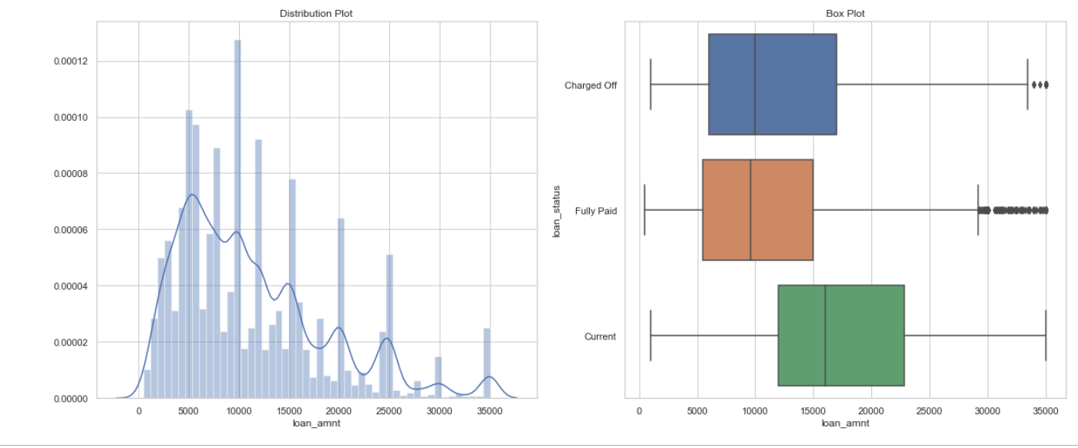
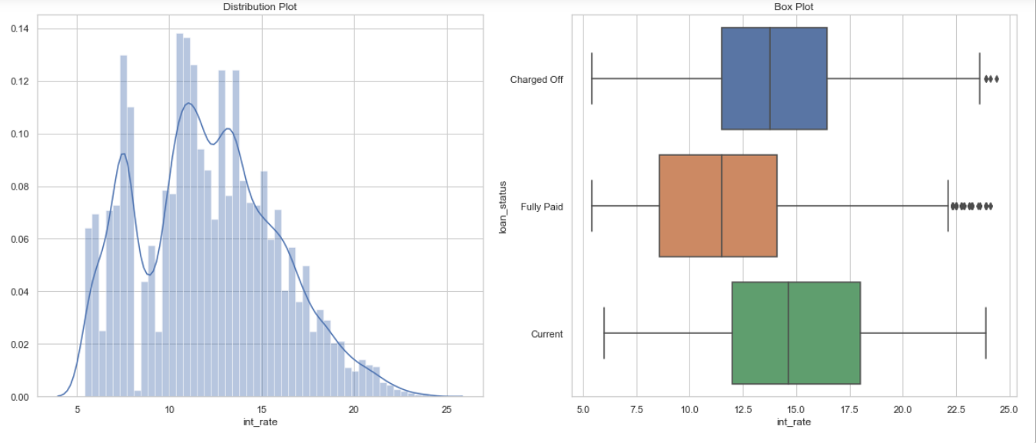
Analysis – Univariate
Loan Amount
The fully paid loan could be discounted from analysis as this does not provide any insight
From the boxplot it can be inferred that the charged off amount has wider range from 50th to 75th quartile i.e. from 10k to 17 k.
Most of the loan amounts is around 5000 USD
Interest rate
The interest rate range is from 5.42% to 24.4 %
The interest rate for charged off loans are generally higher than fully paid loans

Slide 5
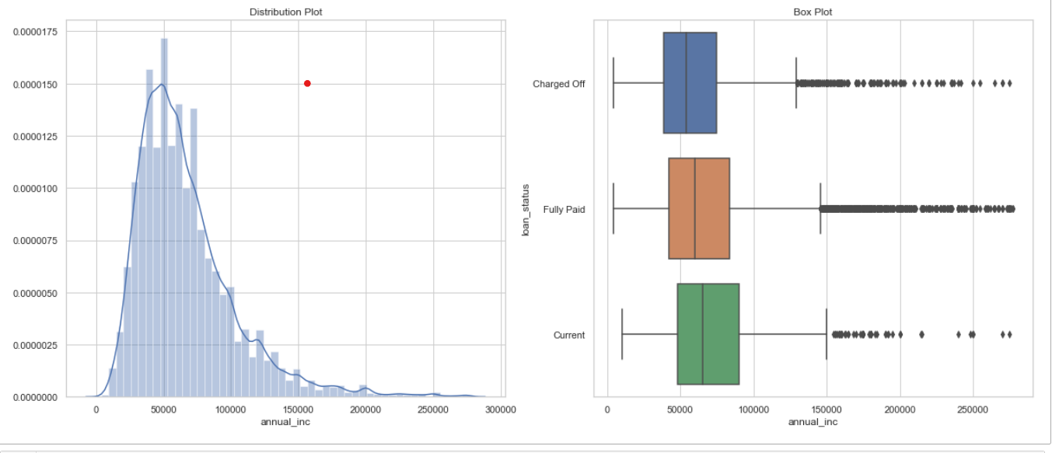
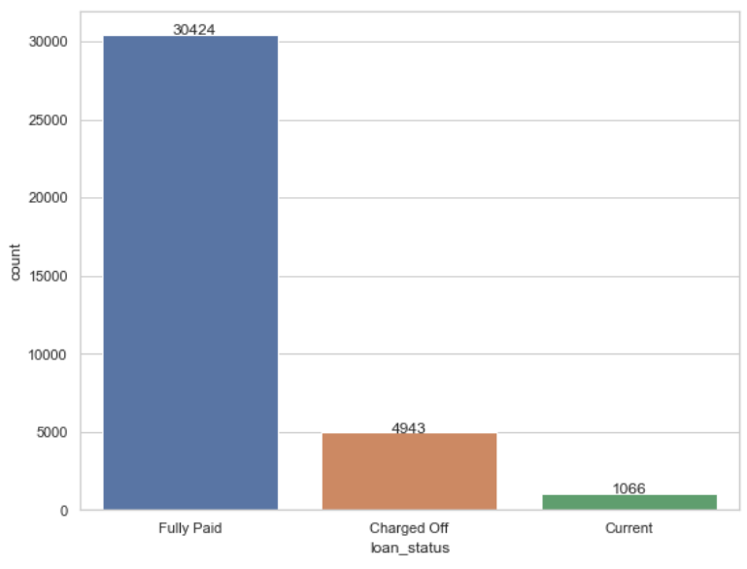
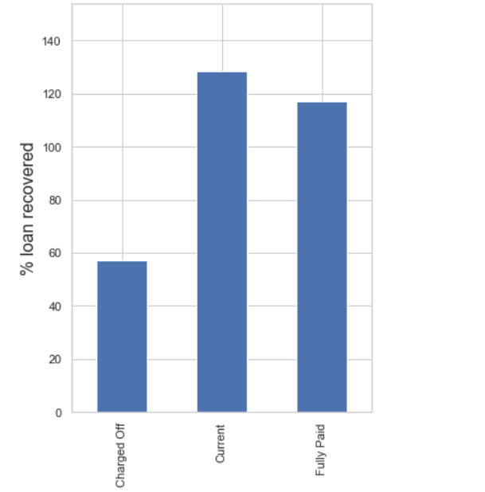
Analysis – Univariate(Contd.)
Annual Income
Most of the loan borrowed fall between the 4,000 usd to 90,000 USD
The average loan taken is about 66.680 USD
The charged off amount is slightly right skewed but there is not much difference between 25th-50th quartile and 50th-75th quartile
Loan status
Approximately 14% of the borrower defaults on the loan
Approximately 84% of the borrower settled the loan
Loan recovered
For the defaulted loan only 57% of the amount are recovered.
For the fully paid loan the club makes a revenue of ~17% of the amount

Slide 6
Analysis – Univariate(Contd.)

